Slide 1

Module 10: Migrating DAC Repository
0/5
Analytics: Advanced Data Warehouse Developer
Notes:
Time: Lecture: 15 – 20 minutes; Labs: 5 – 10 minutes
Intent: To learn to migrate DAC repository from one environment to another environment.
Flow: Describe the DAC repository migration process; describe the export process; list the different export options; describe the import process; list the different import options
Key Terms:
DAC
Repository
Export
Import
Logical
Run Time
System
10

Slide 2
Module Objectives
After completing this module you will be able to:
  Export and import all or part of the Data Warehouse Application Console (DAC) repository metadata
  Migrate a DAC repository from one environment to another environment
Why you need to know:
  You need to know how to migrate the entire or part of the DAC repository from one environment to another environment
Notes:
Each objective and “why you need to know” should be stated aloud.

Slide 3
DAC Repository Migration
Use DAC export and import process to propagate a DAC repository containing development changes from one environment to another environment
  For example, you want to migrate the entire DAC repository from test to production environment after development testing is complete
Export all or part of the DAC metadata
Notes:
This slide provides an overview of how DACs export and import processes can be used to migrate a DAC repository from one environment to another environment. These processes can also be used to backup a DAC repository to prevent data or ETL development loss due to hardware or software failures.
10

Slide 4
Exporting the DAC Repository—Steps
0/4
1. Start the export
2. Select the export directory
3. Choose the export option
4. Verify export
Notes:
This is a structuring slide. Do not teach the steps or concepts here because the following slides cover them in detail.

Slide 5
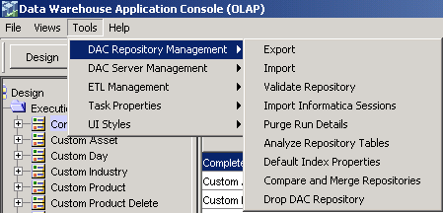
1. Start the Export
1/4
Select Tools > DAC Repository Management > Export to start the export
Notes:
This slide details the process to backup a DAC repository.
10

Slide 6
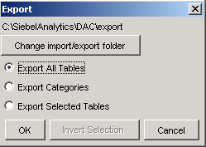
2. Select the Export Directory
2/4
Change the export directory
  The default export directory is C:\SiebelAnalytics\DAC\export
Default export directory
Notes:
The default export directory contains XML files used to create out-of-the-box DAC repository. To avoid overwriting them, either these XML files need to be copied over to a different directory or new export files are saved to a different default directory.

Slide 7
3. Choose the Export Option
3/4
Use one of the following export options:
  Export All Tables – exports the entire DAC repository
  Export Categories – exports a logical portion of the DAC repository
  Export Selected Tables – exports one or more selected tables from the DAC repository
    Not recommended
    Can compromise the integrity of the export
Select one of the export options
Notes:
This slide lists the available export options.
10

Slide 8
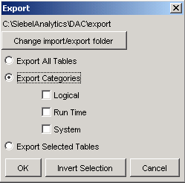
3. Choose the Export Option Continued
3/4
Use one of the following export categories to selectively export a logical portion of the DAC repository
  Logical – All information contained in the Design view and database connection information
  Run Time – All information contained in the execute view
  System – All information contained in the Setup view except passwords for servers and database connections
Select one of the categories to export
Notes:
This slide lists the available export categories.

Slide 9
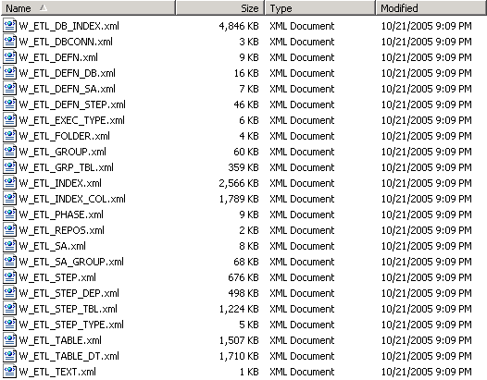
4. Verify Export
4/4
Navigate to the export directory to confirm the existence of XML export files
Compare the file creation time to the time of export
Notes:
The number of export (XML) files varies based on the type of export option and category chosen during the export process.
10

Slide 10
Importing the DAC Repository—Steps
0/4
1. Start the import
2. Select the import directory
3. Choose the import option
4. Verify import
Notes:
This is a structuring slide. Do not teach the steps or concepts here because the following slides cover them in detail.

Slide 11
1. Start the Import
1/4
Select Tools > DAC Repository Management > Import to start the import
Notes:
This slide details the process to backup a DAC repository.
10

Slide 12
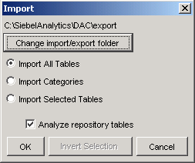
2. Select the Import Directory
2/4
Change the import directory
  The default import directory is the same directory where the DAC repository is exported
Click to specify a different import directory
Default import directory
Notes:
The default export directory contains XML files used to create out-of-the-box DAC repository. To avoid importing out-of-the-box repository, change the import folder to a location where the exported XML files are located.

Slide 13
3. Choose the Import Option
3/4
Use one of the following import options:
  Import All Tables – imports the entire DAC repository
  Import Categories – imports a logical portion of the DAC repository
  Import Selected Tables – imports one or more selected tables into the DAC repository
    Not recommended
    Can compromise the integrity of the import
Allows you to run analyze table commands for all the DAC repository tables
Notes:
This slide lists the available import options.
10

Slide 14
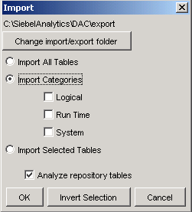
3. Choose the Import Option Continued
3/4
Use one of the following import categories to selectively import a logical portion of the DAC metadata into the repository
  Logical – All information contained in the Design view and database connection information
  Run Time – All information contained in the execute view
  System – All information contained in the Setup view except passwords for servers and database connections
Select one of the categories to import
Notes:
This slide lists the available export categories.

Slide 15
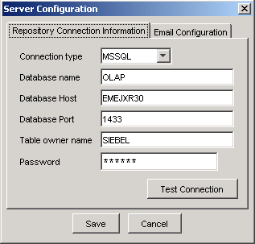
4. Verify Import
4/4
Close and login back to the DAC client to verify the following:
  The DAC client connectivity to the DAC server
  The DAC Server connectivity to Informatica, Siebel transactional database, and Siebel Relationship Management Warehouse
Verifies the connection between the DAC client and DAC server
Notes:
Stop and restart the DAC server before logging back in to the DAC client for verification.
10

Slide 16
Summary
This module showed you how to:
  Export and import all or part of the Data Warehouse Application Console (DAC) repository metadata
  Migrate a DAC repository from one environment to another environment
Notes:
This slide presents a summary of the topics covered in the module.

Slide 17
Lab
In the lab you will:
  Perform steps to export and import the DAC repository
Notes:
Labs and Troubleshooting:
In this lab, students are asked to export and import a DAC repository and verify that they are able to connect to the DAC client using the imported DAC repository.
10

